Slide 1
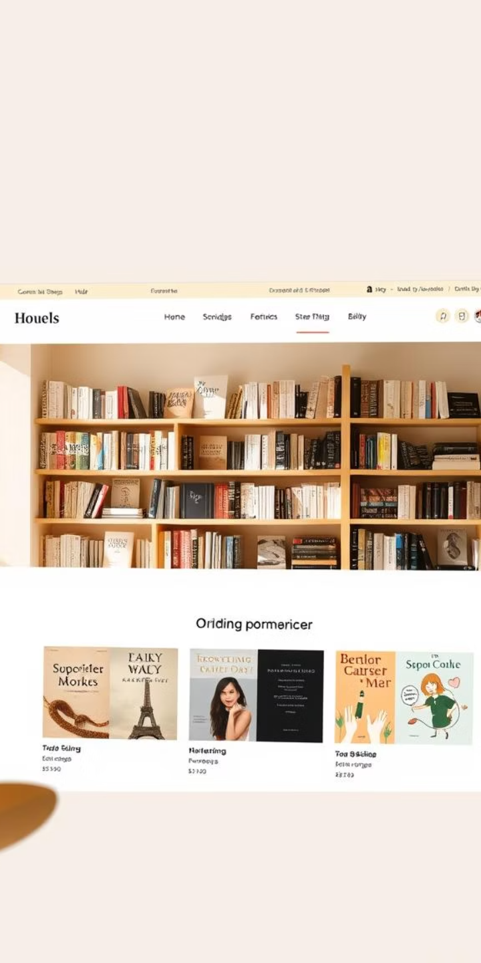
Vendora: Your Online Bookstore Solution
Vendora
Vendora is a full-stack e-commerce platform designed for buying and selling books. It combines React.js frontend with Node.js backend and MySQL database. Core features include user authentication, product listings, cart, and admin tools. Our goal is a smooth, responsive, and scalable shopping experience.

Slide 2

The Need for Vendora
Growing Market
The online book market hits $25B in 2024 with 5% growth.
Market Gap
Major platforms overlook niche genres and used books buyers.
Target Audience
Primarily 25-34 year olds fueling online book purchases.
Community Focus
Vendora fosters a book-loving community with personalized features.

Slide 3

Frontend: React.js Interface
Component Based
Reusable UI components for consistency and maintainability.
Responsive Design
Optimized for desktop, tablet, and mobile over 90% mobile traffic.
Material UI
Ensures modern, consistent, and attractive interface styling.
API Handling
Axios library manages efficient communication with backend.

Slide 4

Backend: Node.js and Express.js
RESTful API
Clean and scalable architecture for frontend-backend interaction.
High Scalability
Designed to handle growing user base and traffic spikes.
Security
Industry standards for secure data handling and user privacy.
Performance
Average server response time maintained at 200 milliseconds.

Slide 5
Database: MySQL Management
Efficient Storage
Normalization
Structured schema supports fast and reliable queries.
Eliminates redundancy, ensuring data integrity and speed.
Connection Pooling
Database Size
Optimized connections for handling multiple simultaneous queries.
Currently managing 500MB of book and user data.

Slide 6




Core Features: User Authentication (JWT)
Secure Registration
Users can register and login safely with encrypted passwords.
JWT Authentication
JSON Web Tokens manage session security and identity verification.
Role-Based Access
Different access levels for users and admins enhance control.
Password Protection
Bcrypt hashes passwords to prevent unauthorized access.

Slide 7





Product Listings and Management
Easy Listings
Advanced Search
Inventory Management
Sellers upload books effortlessly with detailed descriptions.
Buyers filter by genre, author, price, and condition.
Sellers track stock status and sales through the dashboard.
Large Catalogue
Over 10,000 books currently available for purchase.

Slide 8
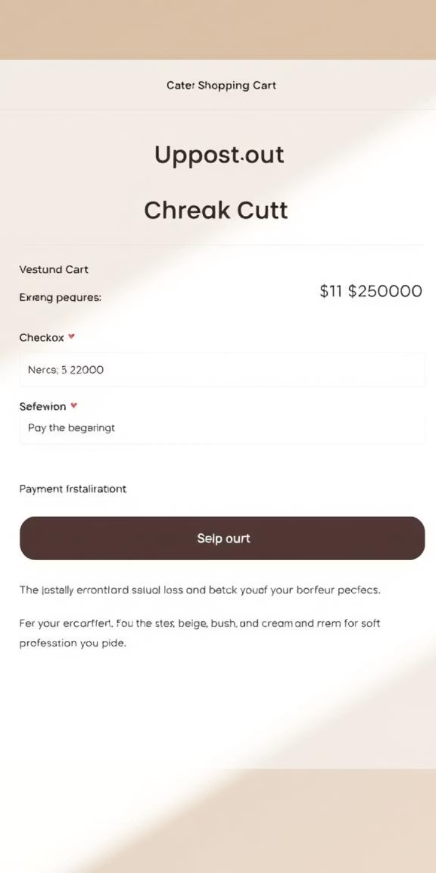
Shopping Cart and Checkout
Checkout
Seamless Cart
Add books easily and track selections in your shopping cart.
Secure Payments
Stripe integration ensures encrypted and reliable transactions.
Order Tracking
Buyers and sellers monitor order status in real time.
Recovery System
Abandoned carts recovery boosts sales by 15% effectively.

Slide 9
Admin Functionalities
Sales & Users
Content Management
Dashboard monitors key metrics for strategic insights.
Admins manage users, products, and categories efficiently.
Analytics
Moderation
Reports aid data-driven decisions for business growth.
System flags and removes spam or inappropriate content.

Slide 10

Vendora: The Future of Online Book Buying
Scalable Platform
Built to grow with increasing users and inventory.
Market Opportunity
Positioned for growth in the expanding e-commerce book sector.
Investment Goal
Seeking $500K seed funding to accelerate development.
Ambitious Targets
100,000 users and 500,000 books by 2026.

